Slide 1
Operationalization of Biometric voter registration
1 November 2016
Presentation by u. silaigwana

Slide 2
iNTRODUCTION
All over the world Election Management Bodies (EMBs) deploy various new technologies with the aim of improving efficiency and effectiveness of the electoral process.
Biometric Voter Registration (BVR) is one such technology.
A Voter registration System for direct data capturing of biometric fingerprints, facial pictures and digital or digitised signature for verification and de-duplication.

Slide 3
What are technologies used for?
Election Administration
Operations/Logistics
Voter Education (VE)/Outreach
Voter Registration
Polling and Counting
Results transmission and Announcement

Slide 4
STEPS TOWARDS Biometric voter Registration
Concept
Feasibility
Proposal
VR Ops Plan
Procure BVR Kits
V E, Training &
Deployment
Data recovery
De duplication
Provisional Voters Roll
Decision
Claims / Objections & continuous VR
Final changes
Final Voters Roll
BVR
Continuous voter registration

Slide 5
BVR – what it can and cannot do
Can | Cannot
Speeds up the process | Change human behavior and attitude
Makes the process more accurate | Fill a political vacuum
Save money in the long-term | Replace human oversight
Facilitates transparency and security
Increases confidence

Slide 6
BVR and its Merits
BVR is informed by regional and global experiences / best practices, long term benefits, ensuring credibility and integrity of voters’ roll.
Addresses issues of possible multiple voting.
Increases transparency of the process.
Enhances accuracy, currency and security among others.
It identifies voters uniquely and is fast, efficient and direct.
Security and privacy of information is enhanced.
Integrity and reliability of information is improved e.g. elimination of duplicates.

Slide 7
BVR is not an election day technology
BVR is the use of Biometric in Voter Registration only
Voter registration is completed well before the election day
BVR systems only register eligible voters as per the country’s legal provisions
It helps in more accurate development of voters’ roll and brings transparency
But BVR systems are not Election Day Technology
BVR is not electronic voting

Slide 8
Biometric characteristics
Finger print DNA
Face Infra-red
Retina Thermogram
Iris Keystrokes
Hand geometry Ear
Voice Odour
Gait Hand vein
Signature

Slide 9
Voter Registration PROCESS
identify yourself at the registration centre by producing your National Registration Card or Passport
Voter Registration Officer quickly captures your personal data
You'll then have your photo, fingerprint taken
Date verified and checked
Voter Issued with confirmation receipt/ card

Slide 10
BVR KIT COMPONENTS
A registration kit comprises of the following essential items:
A laptop (where the application resides. It also provides temporary data storage);
Camera (to capture the registrant’s picture);
Fingerprint scanner (for capturing of registrants’ fingerprints);
Carry case (to carry and shutter protect the kits);
Power Generation kit.

Slide 11
BVR KIT IN PICTURES

Slide 12
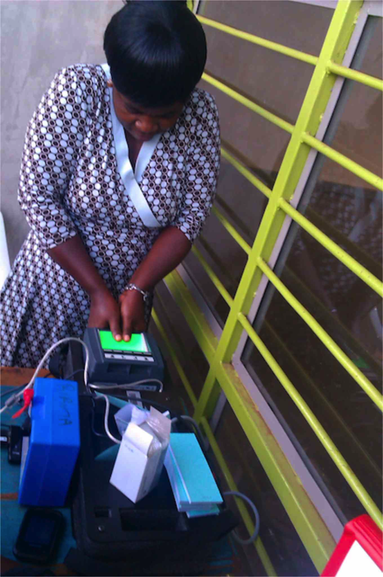
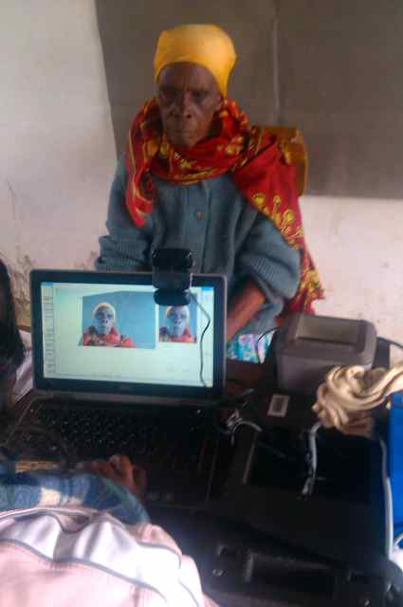
VOTER REGISTRATION PROCESS

Slide 13
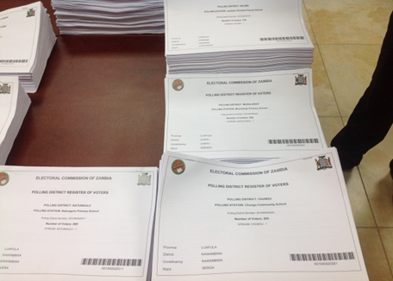
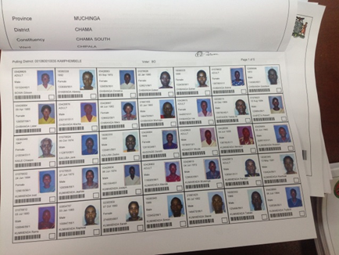
Result: Polling Station Voters’ Roll

Slide 14
KEY FACTORS BEING CONSIDERED BY ZEC FOR VR
For the Voters’ Roll to be comprehensive and inclusive
The process should be accessible to all eligible voters…..Polling stations become VR Centres….10 000 (The current mapping exercise is a precursor to VR)
Enough time for the voters to register at the VR Centres…an average of 15 days with possibility of extension
Availability of trained and qualified staff at the centres
Voter Education will be articulated, in depth and involve CSOs as well as political parties
Limitation of funding means the BVR exercise may be phased

Slide 15
KEY FACTORS BEING CONSIDERED BY ZEC FOR VR
For transparency, accountability and credibility;
Ensure observation of the VR process by stakeholders/observers
Claims and objections process
Provision of the Voters’ Roll to political parties and other stakeholders on request
For security and privacy;
Ensure the security of the database system at ZEC
Ensure the use of information for voter registration only

Slide 16
KEY FACTORS BEING CONSIDERED BY ZEC FOR VR
For Continuity;
VR process to be continuous in nature
As the blitz exercise is completed, District Offices to become permanent VR Centres
For Accuracy;
Use of biometrics to ensure that voters are registered in person
De-duplication exercise to ensure that there are no duplicates
Quality assurance during the voter registration process (observers and supervisors)

Slide 17
KEY FACTORS BEING CONSIDERED BY ZEC FOR VR
For Sustainability and Cost Effectiveness;
Making the process as simple as possible
Endeavour to make the process financially sustainable and cost effective
The process should be completed in 2017.

Slide 18
END OF SLIDES
Thank you
Tatenda
Siyabonga
              Kealeboga!

