Slide 1
ZIMBABWE ELECTION SUPPORT NETWORK 2018 ELECTION DIALOGUE FOR SUSTAINABLE ELECTORAL REFORMS IN ZIMBABWE

Slide 2
An investigation into the nature of electoral related conflict in Zimbabwe and the effectiveness of the existing dispute resolution mechanisms.
Tino Bere
Legal Practitioner
…past ZESN Chairperson

Slide 3
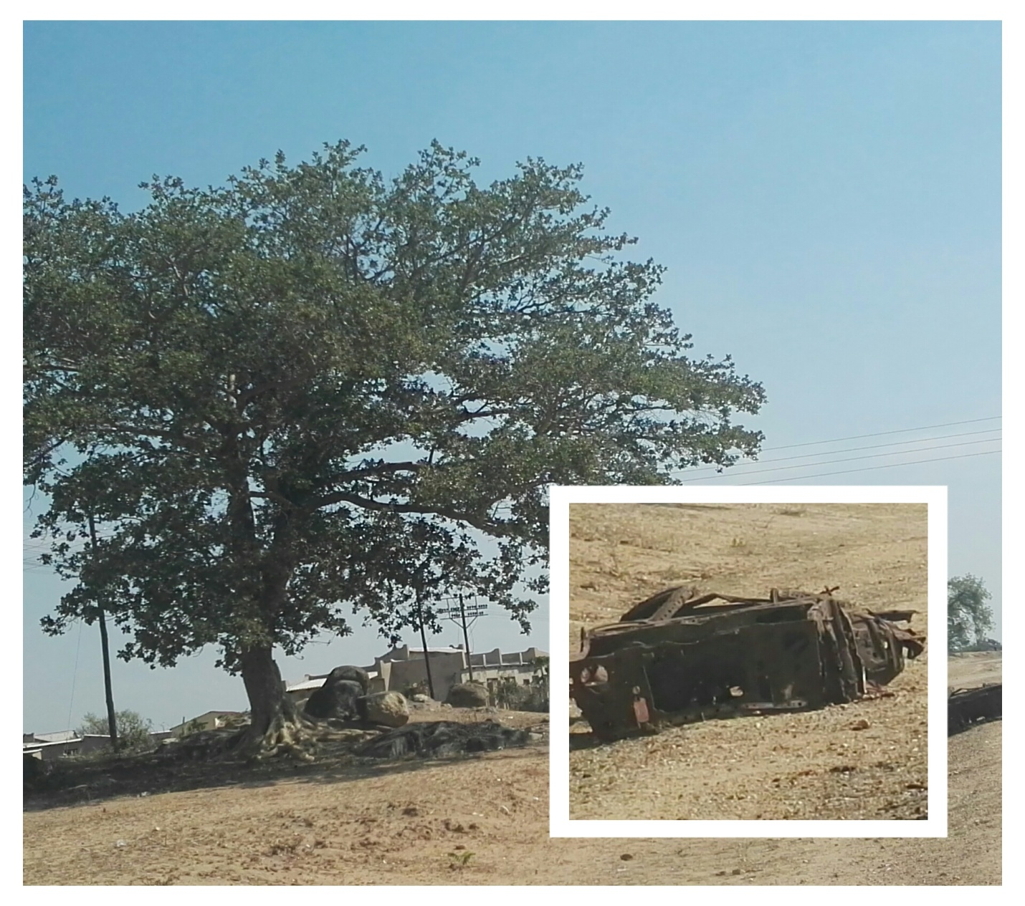
..just one of the unresolved ones

Slide 4
THE MEANING
…contestation for space and strategic positions before, during or after elections (that is any part of the electoral cycle), in order to gain advantage or influence or impose an outcome
….often between individuals, within or between communities, within or with political parties, between political parties, between people and the state, between(state institutions or office bearers in state institutions)

Slide 5
THE MEANING cont.1
Expresses itself in many forms, acted out verbally or non verbally but continuously and at times for generations
Actions may be positive or negative, avoidance, contest or collaboration or silence
Shows itself through institutions protecting certain interests or refusing to play their protective role or playing it selectively or suppressing certain interests.
Levels range from personal, community, groups, political parties, national or even international.
Stages can be categorised as surface/shallow, latent/deep, open/direct, escalation

Slide 6
THE MEANING cont..2
THE MOST VISIBLE sibling…. Political violence
..It is organised acts or threats- physical, psychological and structural aimed at intimidating, harming, blackmailing a political stakeholder before, during and after elections with a view to determine, delay or influence an electoral process… (Albert,2007).

Slide 7
History/Culture of Conflict
Precolonial (tribal and feudal conflict)
Colonial (violent dispossession)
Liberation era (atrocities)
Independence (atrocities & repression)
Post colonial (socialist era)
Post socialism era (nationalism)
The right to rule for eternity
ESAP era to today

Slide 8
Nature of Conflict
Unresolved conflict
Weak or unjust or partisan institutions
Impunity (Lack of rule of law)
Weak or unjust legal framework for elections
Weak or partisan leadership & staffing for E. Body
Defective of biased electoral processes
Unjust laws, unjust processes & oppressive climate
Winner take all electoral process
Centralisation of power, command culture
Elevated cost of losing

Slide 9
Causes or Triggers of Conflict
Unresolved conflict
Weak or unjust or partisan institutions
Impunity (Lack of rule of law)
Weak or unjust legal framework for elections
Weak or partisan leadership & staffing for E. Body
Defective of biased electoral processes
Unjust laws, unjust processes & oppressive climate
Winner take all electoral process
Centralisation of power, command culture
Elevated cost of losing

Slide 10
Players in Political Conflict
Intolerant individual
Intolerant communities
Political parties and or members of such
State institutions (bias, neglect, violation)
State arms (dereliction or violation)
Leaders in community, parties, government
Threatened rulers

Slide 11
LEADING EXAMPLES OF ELECTORAL RELATED CONFLICT IN ZIMBABWE
OUTRIGHT VIOLENCE AND INTITMIDATION (pre)
DISENFRANCHISEMENT (REGISTRATION, QUALIFICATION, VOTING, COUNTING, MANAGEMENT OF RESULTS).
IMPEDING SOME AND ENABLING OTHER COMPETITORS (voters rolls quality and or access)
ABUSE OF THE SPECIAL VOTING SYSTEM
INTIMIDATION/VIOLENCE AND VOTING UNDER DURRESS. (during)
VOTE BUYING or politicisation of state resources.
STAFFING state institutions with partisan personnel
HIGH HANDENESS in electoral administration.

Slide 12
NATURE OF ELECTORAL RELATED CONFLICTS IN ZIMBABWE
Gross state media monopoly and bias
Criminalisation of voter education
Abuse or theft or state resources for POLITICAL PARTIES
Criminalisation of dissent or expression of such
Dem0nisation of democratic discourse.
Mistrust of institutions, persons and processes.
Conflicted roles of key personnel.
Double standards in application of rules or laws.
Impunity by those above the law.
Discord between good framework and culture, practice, ideology
Notes:
Tinoziva Bere is a Senior lawyer and former Zimbabwe Electoral Support Commission Network Board Chairperson. Email: tinoziva@berebrothers.com

Slide 13
EXPERIENCE OF EFFECTIVENESS OF THE EXISTING DISPUTE RESOLUTION MECHANISMS
ZEC
  LEADERSHIP AND STAFFING
  RESOURCES
  TRUST LEVELS
  DAMAGED TRACK RECORD
  WEAK OR BIASED STATE INSTITUTIONS
COURTS
  Complicity in results delay
  Technicalities to shoot cases
  Zeal to support gvt early elections
  Poor jurisprudence

Slide 14
EXPERIENCE OF EFFECTIVENESS OF THE EXISTING DISPUTE RESOLUTION MECHANISMS
LAW
  CONFLICT BASED
  WINNER TAKE ALL BASIS
  TOO TECHNICAL
  REACTIVE
  PARTISAN APPLICATION
  BADLY ADJUDICATED
COURTS
  Complicity in results delay (LETTING FIRES RAGE)
  Technicalities to shoot cases, mad rules
  Zeal to support gvt early elections (STARTING FIRES)
  Poor jurisprudence
  NO URGENCY to hear or rule
  EXCUSES

Slide 15
EXPERIENCE OF EFFECTIVENESS OF THE EXISTING DISPUTE RESOLUTION MECHANISMS
COMMUNITY
  UNDERMINED TRANDITIONAL SYSTEMS
  DISMPOWERED OR POLITICISED TRADITIONAL LEADERS
  PARALYSIS OF COMMAND STRUCTURE
  POLITICAL PATRONAGE
POLITICAL PARTIES
  CULTURE OF INTOLLERANCE
  SURVIVAL POLITICS
  IDIOLOGICAL ACID

Slide 16
CONCLUSION
VERDICT
  We have a semblance of correct institutions & laws
  We can tick off the boxes
  But we acting out compliance
Our reality is dictated by our wounded hearts, our scarred minds, and our perverted perception of power and our enculturation to resolve conflict violently and win contests dishonestly and to destroy the opponent.

Slide 17
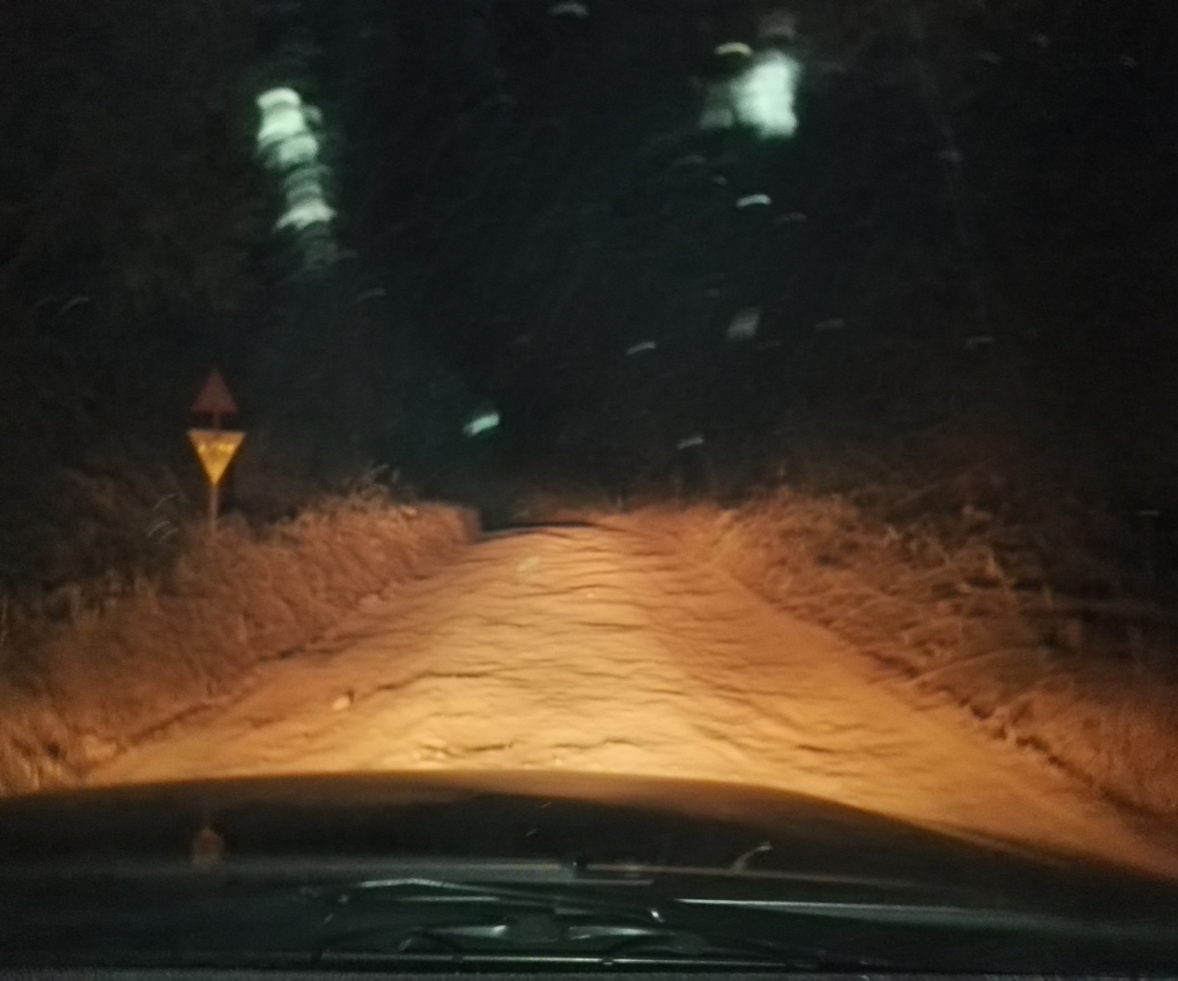
WHERE WE ARE….

Slide 18
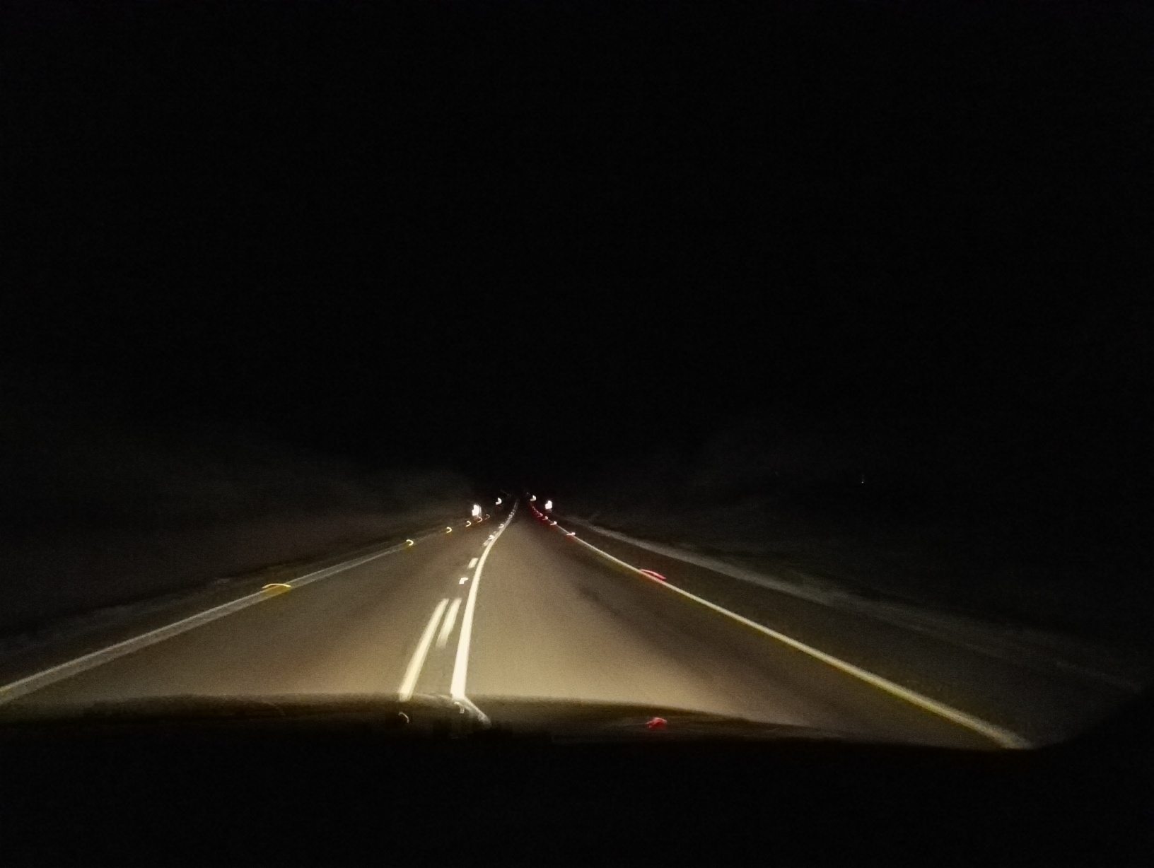
WHERE WE SHOULD BE HEADED

Slide 19
the end

