Slide 1
THE POLITICAL ENVIRONMENT
PROBLEM STATEMENT

Slide 2
BROAD CHALLENGES - Proposals
1. System of intimidation
2. System of patronage
3. System of information control (misinformation)
4. System of exclusion
5. System of weak institutions
6. System of weak (inadequate) laws

Slide 3
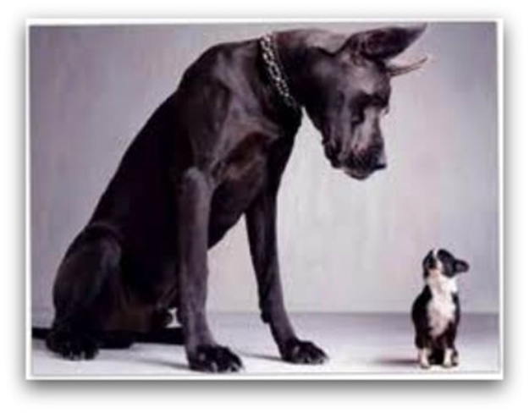
SYSTEM OF INTIMIDATION
Pressure exerted on voters to vote for a particular political party backed by proven and real punishment in the event of an unfavoured election outcome.

Slide 4
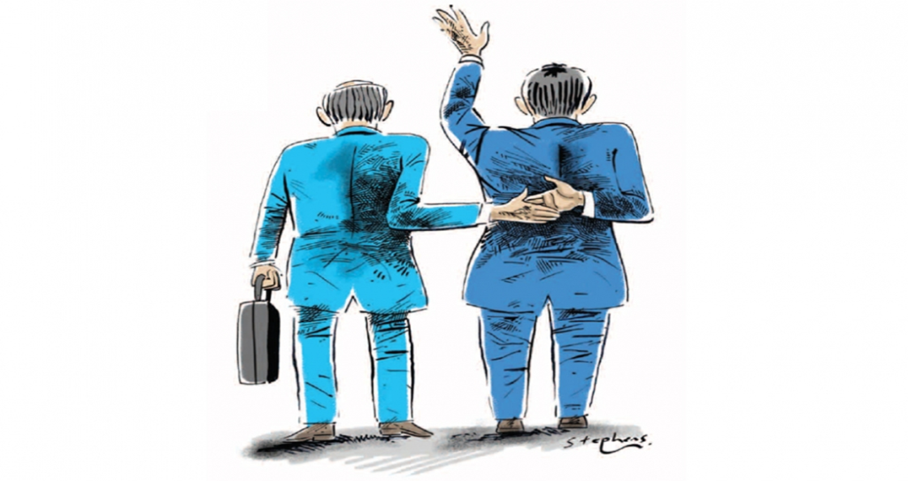
SYSTEM OF PATRONAGE
Use of incentives to motivate favour in elections
Reward loyalty and punish disloyalty
Enforce compliance

Slide 5
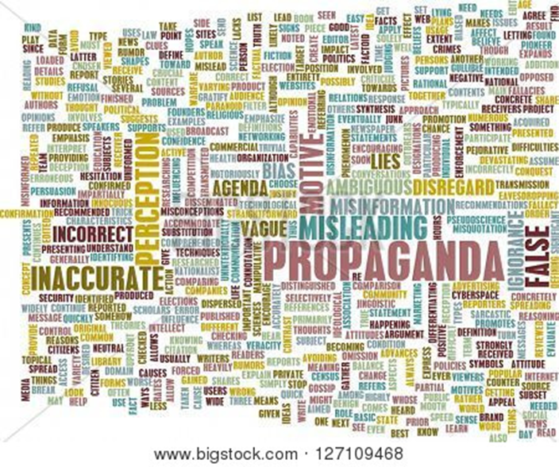
System of Information Control
Misinformation
State monopoly of main information channels is used to benefit one political party
Keep citizens in the dark
Perpetuation of myths
Make unchallenged claims about rivals

Slide 6
SYSTEM OF EXCLUSION
Processed organised to make it easier for one group to benefit at the expense of another
Diaspora
Aliens
Elderly
Youth
Prisoners
The disabled

Slide 7
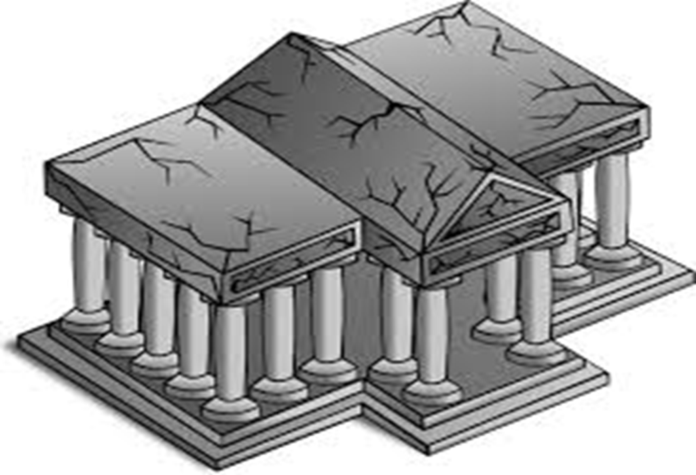
SYSTEM OF WEAK INSTITUTION
Responsible institutions weakened through
1. access to resources
2. inadequate legislation
3. vulnerability to intimidation
4. patronage system

Slide 8
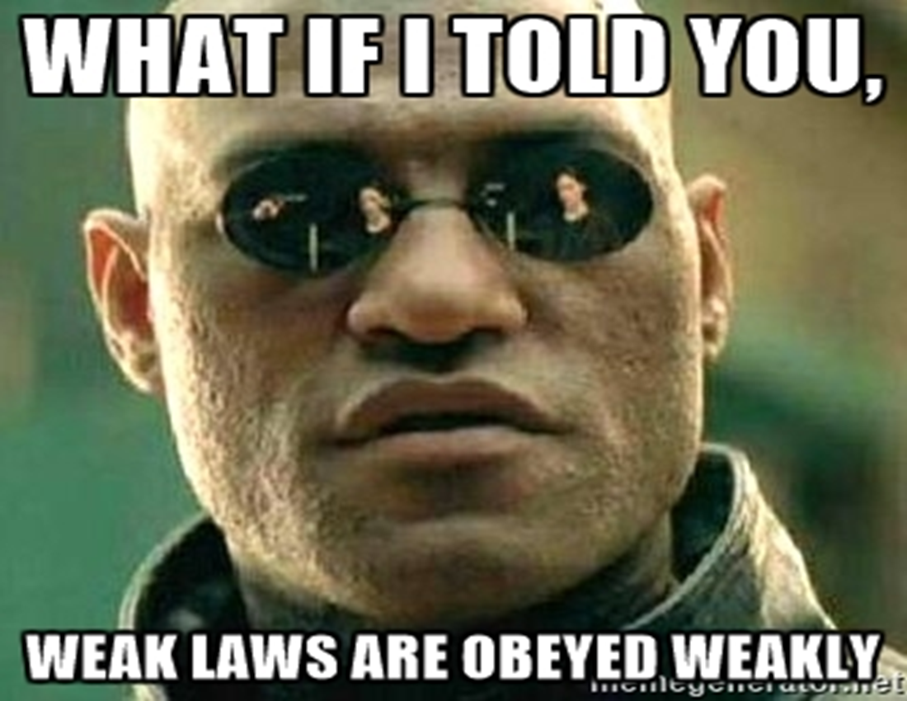
SYSTEM OF WEAK LAWS
Unaligned laws
Limited clarity
Multiple interpretations

Slide 9
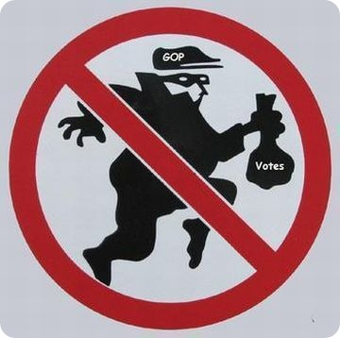
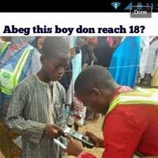
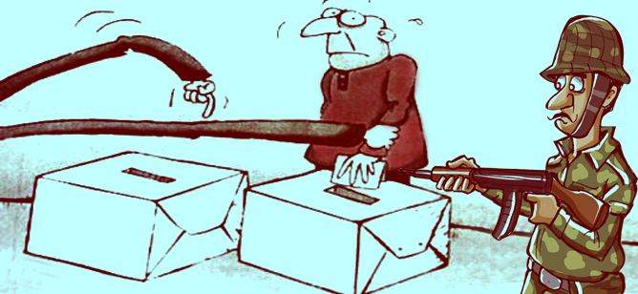
VULNERABILITIES
Systemic Manipulation
Malpractice
Fraud

Slide 10
POSSIBLE APPROACHES
3 major fronts to possibly pursue
1. Legislatively
Fixing the laws, (not just the Electoral Act)
2. Administratively
Focusing on regulations, procedures and assessing the performance of those administrating elections)
3. Political environment
Strengthening of mechanisms to promote a free and fair environment and enforcing existing mechanisms to curb violations

Slide 11
THANK YOU

