Slide 1
“Enhancing transparency and accountability in Elections.”
Opening Electoral Data

Slide 2
An overview
Transparency is a key principle for credible elections.
Process which is open to scrutiny by stakeholders
Independent verification that the process is conducted according to procedures
Enhances trust and confidence of elections

Slide 3
An overview
Transparency in the procurement, development, testing and certification of electoral technology is key
Educate observers and other electoral actors on the use and deployment of technology

Slide 4
An overview
Predictable processes, unpredictable results
Participation and inclusion of all
Transparency in the Results Management. announcement at lowest precincts, efficient transmission & tallying, timely information sharing

Slide 5
Transparency in Elections – The open data approach
Historical Background
  Open government initiatives
  Protocols signed
  Open data principles

Slide 6
“The Operational tendency within government is that Everything is Closed unless it is deemed to be public.”
“Everything is Open,
Unless it is specified as being closed.”
Notes:
This is
1. Most Important thing to remember
The more information is concealed, the more it appears that the process is flawed.
2. Best practices in making Electoral information Open.
6

Slide 7
Public data is public.
Public data ought to be open.

Slide 8
Open Election Data
Open
Transparent
Non – Interference
Effective electoral Process management
Reduce Tension
Generate insights
Free and Fair
Inclusive Process
Barriers to Access Electoral Information
Voter, Political Party, CSO, Participation
Perception
Notes:
Openning Up Data makes it possible to Overcome the Barriers to Access
And has Numerous benefits for EMB’s

Slide 9





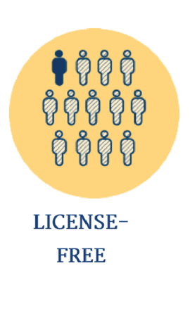



Open Election Data
Confidence
Perception
Principle Guide to Eliminate Barriers to Access Electoral Information
Notes:
Top half relates to What You Publish.
Is it … Timely
The Bottom Half relates to How you Publish
And the Barriers to access that information EMBs accidentally create, or the barriers the break down.
When Done Well these will build trust and confidence, EMB’s will look professional like they know what they are doing and how to do it to best level .

Slide 10
Open Election Data – Timely Release
Post-Electoral Period
System & Boundaries
Pre-Electoral Period
Electoral Period
Audits and Evaluations
Voter Register Updates
Archiving and Research
Voter Registry
Party Registry
Voter Education
Budgeting, Planning and Procurement
Results Tabulation,
Voting
Candidate Registration
Dispute Resolution
Frequent Updates to the data
Data Should be Provided within the limits of different electoral phases, and with sufficient time for the data to inform Decisions / Actions.
Changes in the data should be Annotated to explain the change = Accountability
Readiness and preparedness
Progress Updates during tabulation = increased transparency
Time stamps
Notes:
Examples:
Citizens = need to know, where and how to register, who the candidates are
I for one would like to know how long the cue is at a polling station and is there another polling station in my vicinity that I can vote at.
First time I Voted I waited 9 hours standing in a line. I later learned that there was a voting station at the back on my neighbor an extra 3 Kilometers away that had much shorter lines
Political Parties , the media , CSO, = Need to evaluate the electoral process, was there any mal practice, Anomalies
EMB’s
For Electoral management bodies, the sooner this data is released the better they are able to demonstrate the trustworthiness of the data, and their ability to mange the process.

Slide 11
Open Election Data – Granularity
Finest possible level of granularity or detail.
  Polling Stations
  1+1 = 2 VS 1 + X + Y + Z = 35
Is it the Primary Source?
No Aggregates Permitted
  Aggregates, Hide Anomalies, if any exist.
  Refusal to provide granular data, makes it look like there is something being hidden.
Voter Registry
  How much should be Provided?
Notes:
If the data protection bill comes in to effect there could be limitations on what can be provided in order to protect people Privacy, as we seen this in the evolution of the MPESA transaction record books.
Remember, its not about EMB’s Its about the Process and its about being honest and open and improving the process.
So it doesn’t mean nothing should be provided when people ask for the voter register, something can be provided. EMB’s can take a good look and evaluate what can be left out.
NTSA Example, We want to publish log book and motor vehicle registration numbers.
And we primarily anonymize it so we protect individuals, but have access to the useful information. The Car Model, Engine Capacity, Year of Manufucture etc etc,
We also protect information of National Security making it difficult to tell vehicles belonging to The Police, or the Military, or even how many come in to the country and where they go.

Slide 12
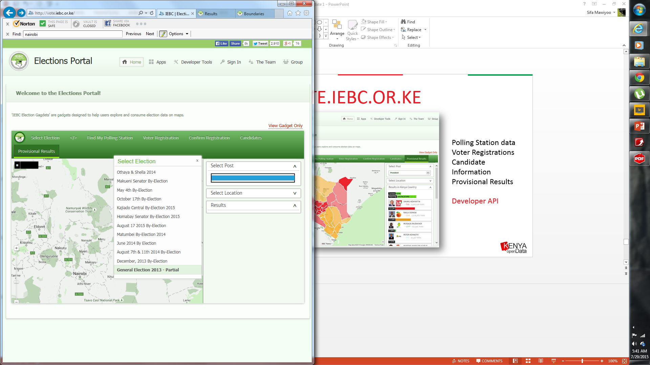
Open Election Data – Completeness
Data Should be Available as a Whole.
Clear Act of Transparency

Slide 13
Open Election Data – Completeness
Data Should be Available as a Whole.
Clear Act of Transparency
Data should be accessible in Bulk with a single click in a Single File or Batches if they are too large
Part of being complete is Proper Documentation
  Field keys, descriptions, notes on last update

Slide 14
Open Election Data – Analyzable
Analyzable means the data is:
  in a raw format,
  Machine readable
Appropriate Formats for Appropriate Uses,
  XML, CSV, JSON
Digital does not mean Machine Readable.
  i.e a PDF is suitable for Print and Reading is Less suitable for Analysis
Notes:
KNBS, census data,
If you ask for the raw data they’ll give you 10% of the data
Predominantly give you the data as a PDF.
Mean while the actual use and reuse value if being able to split and recombine data 100 different ways.

Slide 15
Open Election Data – Non Proprietary
Proprietary formats are, by definition, are restrictive either of the ability to use the information or the ability to share the information
Data is Best released in Open File Formats –
  CSV, XML, JSON,
    Adobe reader is Open but only suitable for print
    XLS and DOC are Proprietary
Notes:
This is where KNBS’s approach to data dissemination and Open Data Approaches Differ
KNBS will provide micro data upon request and subject to evaluation
But they provide it using a proprietary format SPSS
A standard annual license is over 5000 dollars.

Slide 16
Open Election Data – Non Discriminatory
no usage restrictions
made available to any individual or organization without limitations based on user identity or intent in order to truly unleash its potential.

Slide 17
Open Election Data – Freely Available Online & Offline
Free – at no cost to citizens
– i.e. On Opendata.go.ke
Should be Discoverable in Well Known Locations
Permanent Links
Offline on CD, and Flash Drives and in Circulation

Slide 18
Open Election Data – License Free
Should be available through a license that Maximizes Re-Usability of the data.
Enables innovation, research, redistribution
Kenya Open Data Uses the Creative Commons CC Zero Universal 1.0 licensing standard. Offer the most options to the reuse of public data.
Other options also include the Open Data Commons Open Database License (ODbL) or Public Domain Dedication License.
Notes:
But we would request for getter consultation on the best format, and harmonizing the licensing standard

Slide 19
Open Election Data – Timely Release
Elections Data should be available indefinitely.
Accessible through permanent URLs,
Should provide data in directly comparable forms and standards.
Permanence also means, a Current Dataset becomes Historical following an election cycle Even if the data is Reused in the following Election cycle.

Slide 20
Some African stories on Open data in elections
Burkina Faso Open Data Initiative (BODI)
  Within hours of the polls closing, results from 21 districts were made openly available via a mobile-responsive web app, run by the team during 2015 elections.
  Worked with CENI to develop a quick results verification system.
Ushahidi platform in Kenya
  Crowd sourcing for incident reporting
  Rapid response on incidences observed

Slide 21
Some African stories on Open data in elections
GoToVote platform
  Set up in Ghana, Malawi, Zimbabwe, Uganda, Kenya
  Assist voters on registration process and info
  In Malawi platform used to make corrections on voter details

Slide 22
Case study- Kenya open electoral data taskforce
Inaugural conference on open electoral data held in Nairobi July 2015
Co hosted by ELOG and IEBC. Technical support by NDI
Taskforce chaired by ELOG formed and comprised of the EMB, KODI and private data practitioners (ushahidi & others)
Taskforce has identified data sets that should be open for the 2017 elections
Survey on utilization of open data in elections conducted by ELOG
Proposals for policy framework being drafted
Monthly meetings on progress already set up.
Engagement of data users envisaged

