Slide 1
The Biometric Voter Registration system in Africa-”
Drawing good practises and lessons learnt

Slide 2
Principles of voter registration process
Integrity
Inclusiveness
Comprehensiveness
Accuracy
Accessibility
An informed public
Stakeholder participation
Transparency
Security
Privacy of information
Cost-effectiveness
Accountability
Credibility
Admin & political feasibility
Sustainability

Slide 3
Introduction of the BVR systems in Africa
Intended to address the following
Cleaning of the voter register (De-duplication, dead voters)
Efficiency
Improve the quality of the voter register
Enfranchise eligible voters
Enhance trust and credibility of the process

Slide 4
Pre-requisites for IT use in voter registration
legal provisions in a country and culturally accepted technology.
political will
The existing conditions and infrastructure
The capacity of the EMB
The environmental conditions in the country
The lifespan and compatibility of the technology
Timing
Financial resources and cost implications
Staff capacity
The ICT capacity in a country

Slide 5
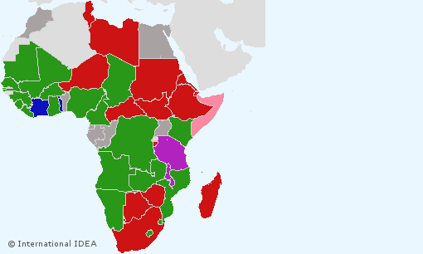
Use of BVRs in Africa

Slide 6
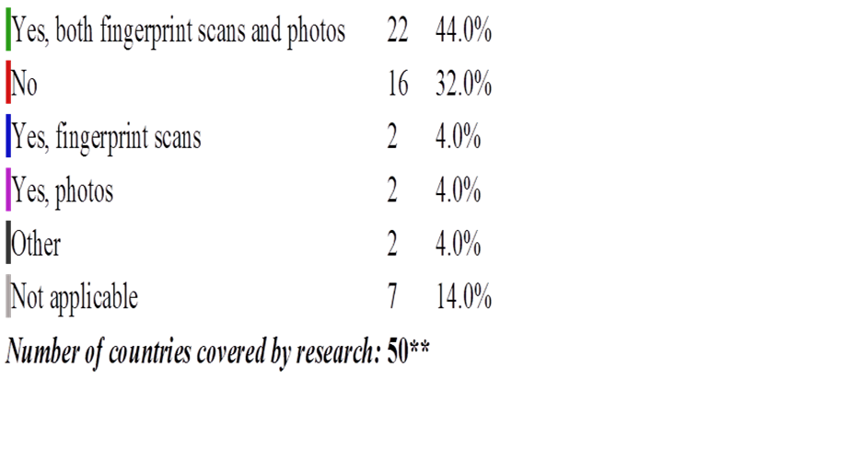
An overview

Slide 7
The good story thus far- Case studies of DRC, Ghana, Liberia, Malawi, Mozambique, Senegal, Rwanda, South Africa and Kenya
Increased voter registration numbers
Higher rate of acceptance than manual systems
Improved participation by the public
Stakeholder confidence boosted
Reduction of double registration
Completeness of the VR
E-register good for updates
Reduction of electoral fraud
More professional mgt. of elections
Generic ID produced as a bi-product

Slide 8
Challenges
Lack of clear legal regimes
Clarity on use of technology
Confidentiality issues
Contingency mechanisms
Range of biometrics
Cost of deployment of electoral technology
Phenomenal increase in cost/voter (from Average of $5/ voter to over $10)
Has led to disenfranchisement of voters in Zambia & Ghana (depressed purchases of equip.)

Slide 9
Challenges
Technical challenges
Capacity of EMB
Testing challenges
Quality of data
Software/hardware needs
Dirty fingers!

Slide 10
Challenges
Integrity factors
Buy-in from voters (local misconceptions)
Buy-in from government
Buy-in from actors (Somalia 2010 BVR abandoned)
Proprietary issues (vendor lock-in)
Procurement processes
Cost of elections
Environmental factors
Infrastructural problem – electricity
Insecurity

Slide 11
Challenges
E-day challenges
little room for error for EVIDs/AFIDs
Time constraints. Long processes witnessed in a number of countries. Goodluck Jonathans experience in Nigerian Elections 2015
Usability of faulty registers

Slide 12
Lessons learnt
Robust legal framework that guides application of technology in Elections. (amended electoral laws –Kenya)
Contingency measures in case of IT failures
Improvement of technology to support more efficient use of BVR. e.g Use of smartcards in some countries (SA). Nigeria has developed permanent a biometric, chip-based permanent voter cards with Card readers deployed at polling stations.

Slide 13
Lessons learnt
Determine the use of BVR. In Cameroun they were used for de-duplication of the register. Clarity on the need is crucial
Robust consultation with electoral stakeholder to create buy-in, transparency and acceptance.
Borrowing of Kits across member states (Kenya -Burundi) may reduce costs

Slide 14
Lessons learnt
Early (and open) procurement process to facilitate testing, training and deployment
Capacity building of the EMB field personnel
Need for a clear and acceptable criteria for deployment of the kits. Skewed distribution can lead to a disproportionate registration of voters.

Slide 15
Conclusions
While BVR have generally increased the efficiency of the VR process the identified challenges should be addressed
Technology is not a silver-bullet to address electoral fraud in Africa
A credible voter register remains a key pillar for genuine elections. Efforts to improve the process must be sought
Elections belong to the people. Public participation in electronically driven processes in crucial for integrity.

